Slide 1
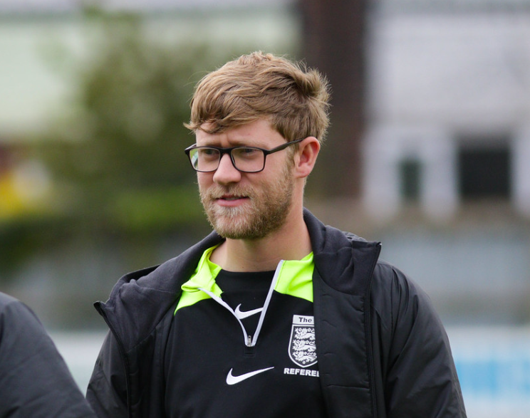
New Referee of the Year
Jack Hargreaves

Slide 2
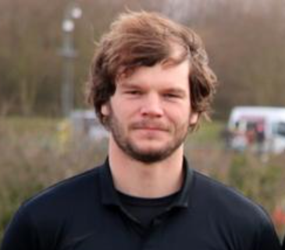
Referee of the Year
Fraser Pemberton

Slide 3
Youth Division White
Leading Scorer (29 goals)
Callum Hayes

Slide 4
Youth Division Blue
Leading Scorer (21 goals)
Lewis Corke

Slide 5
Youth Section
Leading Scorer (33 goals)
Lucas Gornall

Slide 6
Division Three
Leading Scorer (42 goals)
Sam Harwood

Slide 7
Division Two
Leading Scorer (31 goals)
Joseph Richardson

Slide 8
Division One
Leading Scorer (31 goals)
Byron Andrew

Slide 9
Premier Division
Leading Scorer (14 goals)
Harry Fisher

Slide 10
Premier Division
Leading Scorer (14 goals)
Reece Thompson

Slide 11
Open Age Section
Leading Scorer (44 goals)
Jack Mountain

Slide 12
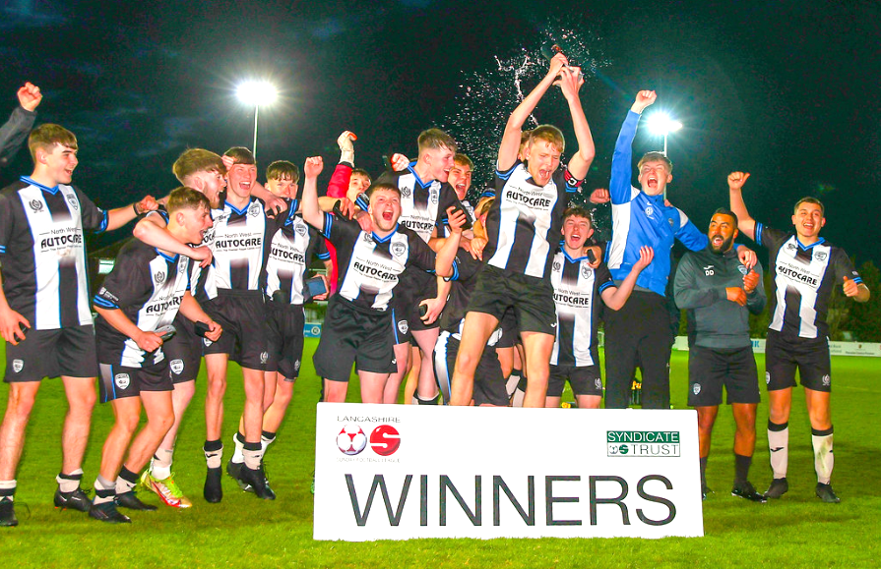
Youth Trophy Winners
Lostock St Gerards

Slide 13
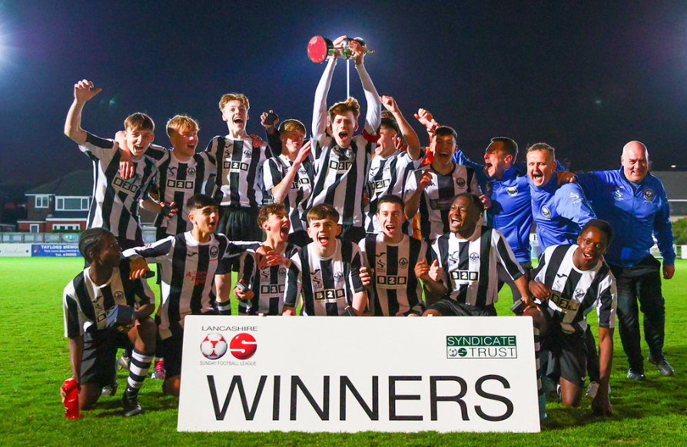
Youth Cup Winners
Atherton Collieries

Slide 14
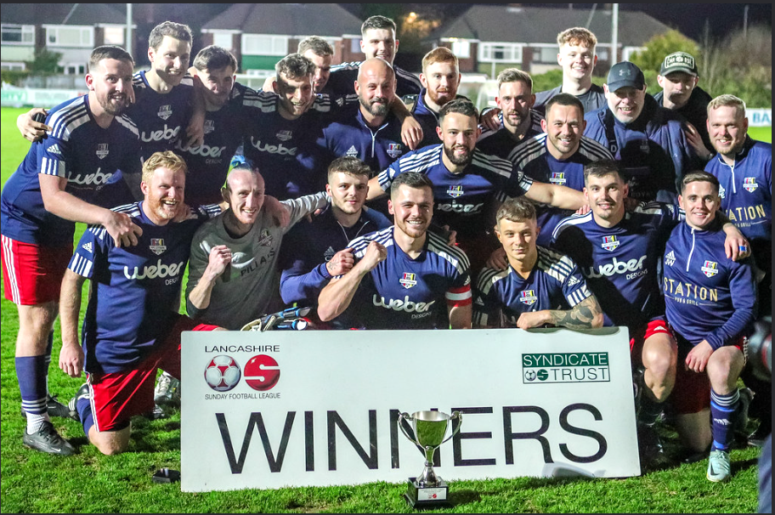
Presidents Cup Winners
AFC Lytham (FY)

Slide 15
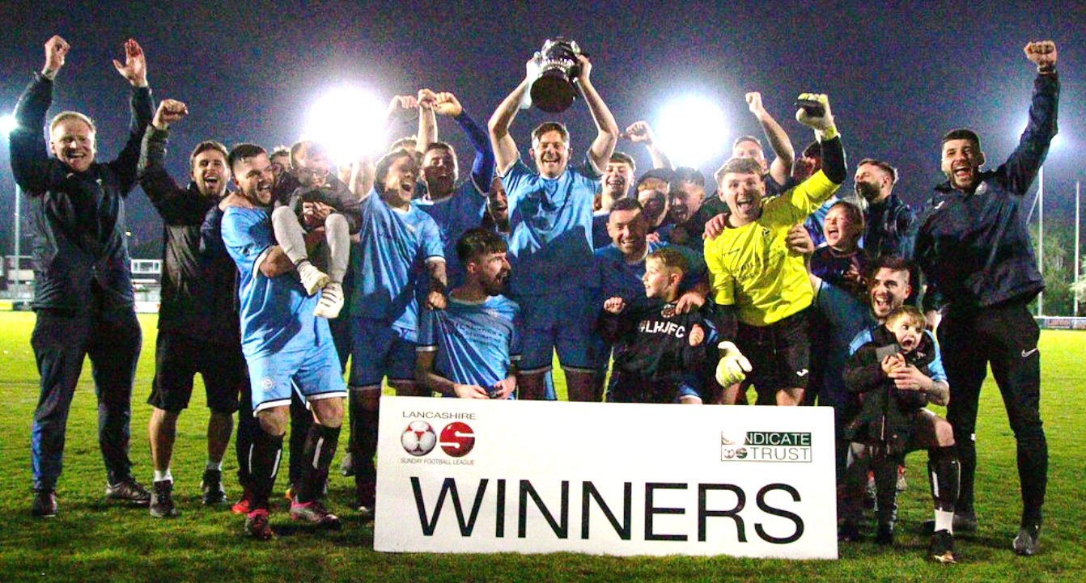
Challenge Cup Winners
Bamber Bridge Utd

Slide 16
Youth Division White
Penwortham St Teresa’s

Slide 17
Youth Division Red
Penwortham Town

Slide 18
Youth Division Blue
Burscough Dynamo U18

Slide 19
Division Four
AFC Lytham (FY)

Slide 20
Division Three
Lancs & Yorks

Slide 21
Division Two
Fulwood & Broughton

Slide 22
Division One
SRDC (Purple)

Slide 23
League Champions
Bamber Bridge Utd

Slide 25
Annual General Meeting
8pm Monday 12th June 2023
@ Acregate Lane Labour Club

